Slide 1
Computer Graphics 10th Recitation “OpenGL: Lighting”
Anna Shtengel
Based on slides by Michael Litvin
18.5.2015

Slide 2
Today!
Repetition
Transformation between 2 coordinate systems
Oblique Projection explanation
OpenGL lighting
Quadrics exhibition Code

Slide 3
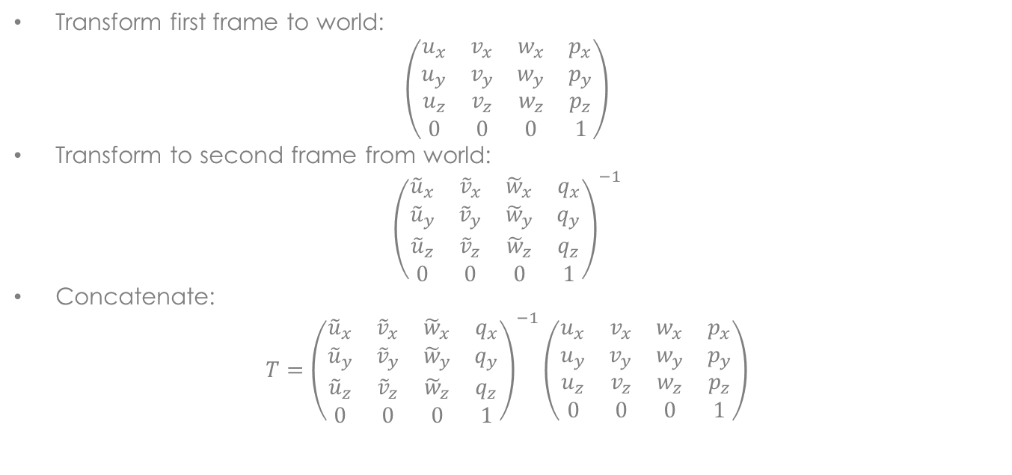
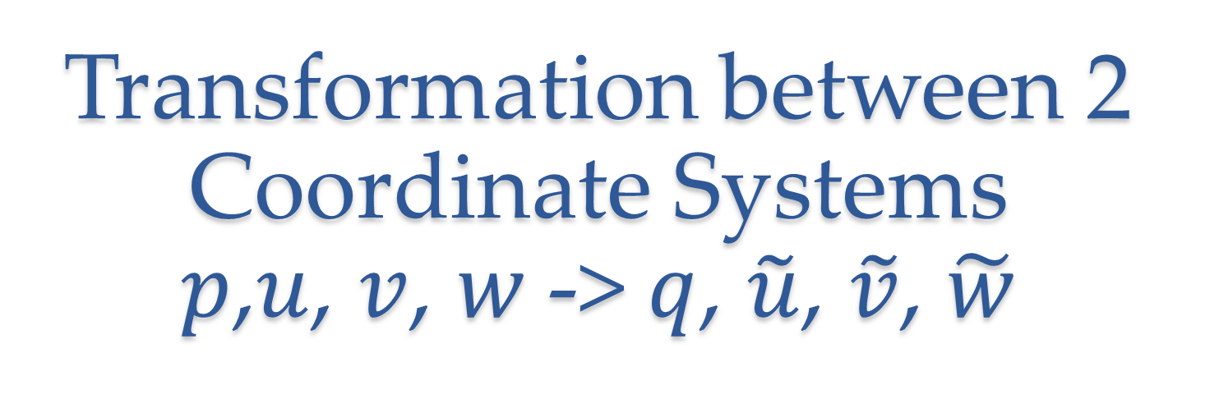
Transformation between 2 Coordinate Systems $p$,$u$, $v$, $w$-> $q$, $\tilde{u}$, $\tilde{v}$, $\tilde{w}$
Transform first frame to world:
$$\left(\begin{matrix}u_{x} & v_{x} & w_{x} & p_{x} \\ u_{y} & v_{y} & w_{y} & p_{y} \\ u_{z} & v_{z} & w_{z} & p_{z} \\ 0 & 0 & 0 & 1\end{matrix}\right)$$
Transform to second frame from world:
$${\left(\begin{matrix}{\tilde{u}}_{x} & {\tilde{v}}_{x} & {\tilde{w}}_{x} & q_{x} \\ {\tilde{u}}_{y} & {\tilde{v}}_{y} & {\tilde{w}}_{y} & q_{y} \\ {\tilde{u}}_{z} & {\tilde{v}}_{z} & {\tilde{w}}_{z} & q_{z} \\ 0 & 0 & 0 & 1\end{matrix}\right)}^{−1}$$
Concatenate:
$$T={\left(\begin{matrix}{\tilde{u}}_{x} & {\tilde{v}}_{x} & {\tilde{w}}_{x} & q_{x} \\ {\tilde{u}}_{y} & {\tilde{v}}_{y} & {\tilde{w}}_{y} & q_{y} \\ {\tilde{u}}_{z} & {\tilde{v}}_{z} & {\tilde{w}}_{z} & q_{z} \\ 0 & 0 & 0 & 1\end{matrix}\right)}^{−1}\left(\begin{matrix}u_{x} & v_{x} & w_{x} & p_{x} \\ u_{y} & v_{y} & w_{y} & p_{y} \\ u_{z} & v_{z} & w_{z} & p_{z} \\ 0 & 0 & 0 & 1\end{matrix}\right)$$

Slide 4
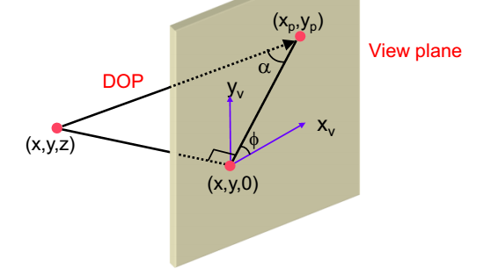

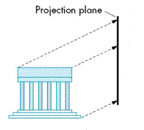
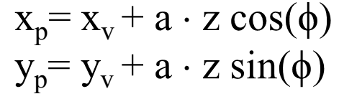

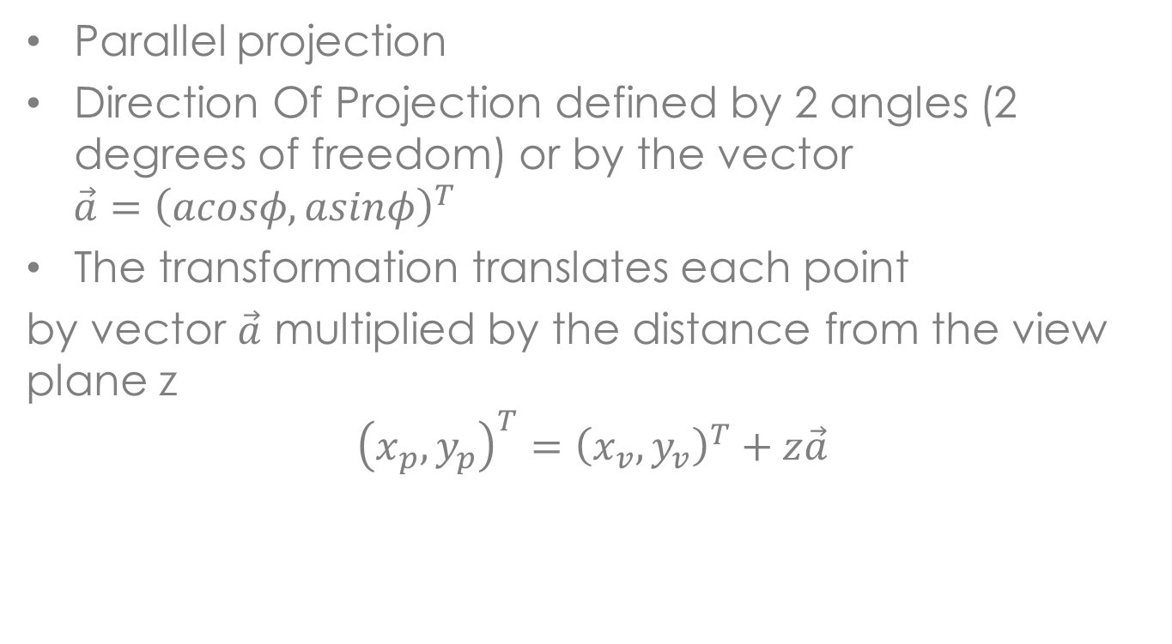




Oblique Projection
Parallel projection
Direction Of Projection defined by 2 angles (2 degrees of freedom) or by the vector
$$\vec{a}={\left(acosφ,asinφ\right)}^{T}$$
The transformation translates each point
by vector $\vec{a}$ multiplied by the distance from the view plane z
$${\left(x_{p},y_{p}\right)}^{T}={\left(x_{v},y_{v}\right)}^{T}+z\vec{a}$$
$$x_{f},y_{f}$$
$$x_{n},y_{n}$$
$$x_{v},y_{v},z_{f}$$
$$x_{v},y_{v},z_{n}$$
$$x_{v},y_{v}$$
Notes:
a= 1/tan(alpha)

Slide 5



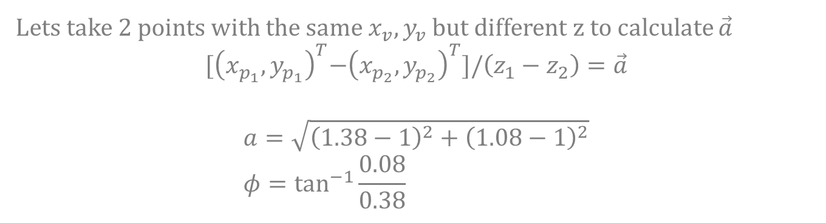




Find The Projection Coefficients
$$y$$
A unit cube parallel to the view plane
$$\left(\begin{matrix}1.38 \\ 1.08\end{matrix}\right)$$
$$1.38$$
$$1$$
$$1$$
$$1.08$$
$$x$$
$${\left(x_{p},y_{p}\right)}^{T}={\left(x_{v},y_{v}\right)}^{T}+z\vec{a}$$
Lets take 2 points with the same $x_{v},y_{v}$ but different z to calculate $\vec{a}$
$${[\left(x_{p_{1}},y_{p_{1}}\right)}^{T}−{\left(x_{p_{2}},y_{p_{2}}\right)}^{T}]/\left(z_{1}−z_{2}\right)=\vec{a}$$
$$a=\sqrt{{\left(1.38−1\right)}^{2}+{\left(1.08−1\right)}^{2}} \\ φ=\tan^{−1}{\frac{0.08}{0.38}}$$

Slide 6
Lighting
No more glColor

Slide 7
Graphical Pipeline
3D Geometric Primitives
Modeling
Transformation
We Are Here
Lighting
Viewing
Transformation
Projection
Transformation
Clipping
Scan
Conversion
Frame Buffer

Slide 8

No Lights

Slide 9

Lights

Slide 10
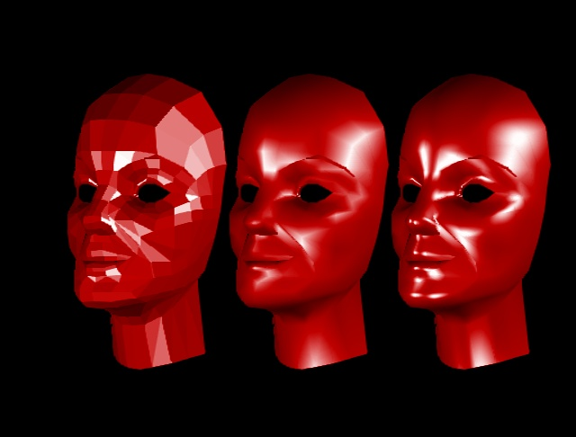
Shading: Flat, Gouraud, Phong
Notes:
Openg-1.ppt
http://www.cs.cmu.edu/~ph/nyit/facet_gouraud_phong.jpeg

Slide 11
OpenGL Lighting Model
Calculates color for each Vertex using Gouraud shading
Ambient, Diffuse, Specular & Emission
Replaces glColor(…)
For the lighting model we have to define:
Normal for each vertex
Material for each primitive
Properties for each light source
Turn on the lights + additional parameters (global)

Slide 12

Step1: Normals
Define normal vectors for each vertex of all the objects.
Call glNormal*() before glVertex*().

Slide 13
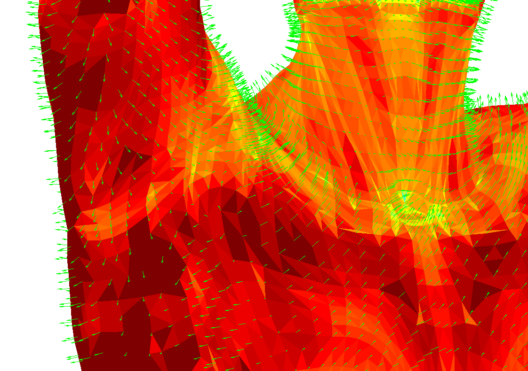
Example
gl.glBegin(GL.GL_QUADS);
gl.glNormal3d(0, 1, 0);
gl.glVertex3d(0, 0, 0);
gl.glVertex3d(0, 0, 1);
gl.glVertex3d(1, 0, 1);
gl.glVertex3d(1, 0, 0);
gl.glEnd();

Slide 14
Normalized Normals
For lighting calculation to go right, normals must be normalized.
OpenGL can automatically takes care of it
glEnable(GL_NORMALIZE)
This is a costly feature but useful because transformations affect normal a
Notes:
T=P1-P2;
N’*T=0
M- model view defined on points, G – the normal matrix
T’=M*T=M*(P1-P2)
N’=G*N
(GN)’*(M*T)=0
N’G’MT=0
G’M=I
G=(invM)’

Slide 15
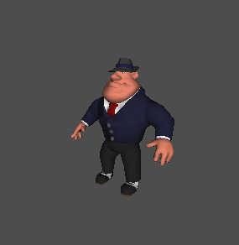
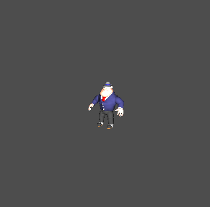
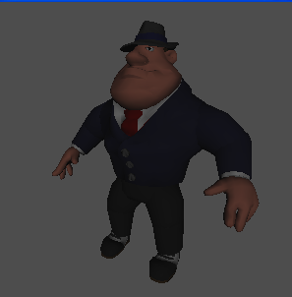
Without GL_NORMALIZE
Original size
glScalef(.3,.3,.3);
glScalef(3,3,3);
Notes:
OpenGL-1.ppt

Slide 16
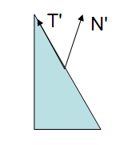
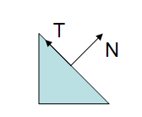
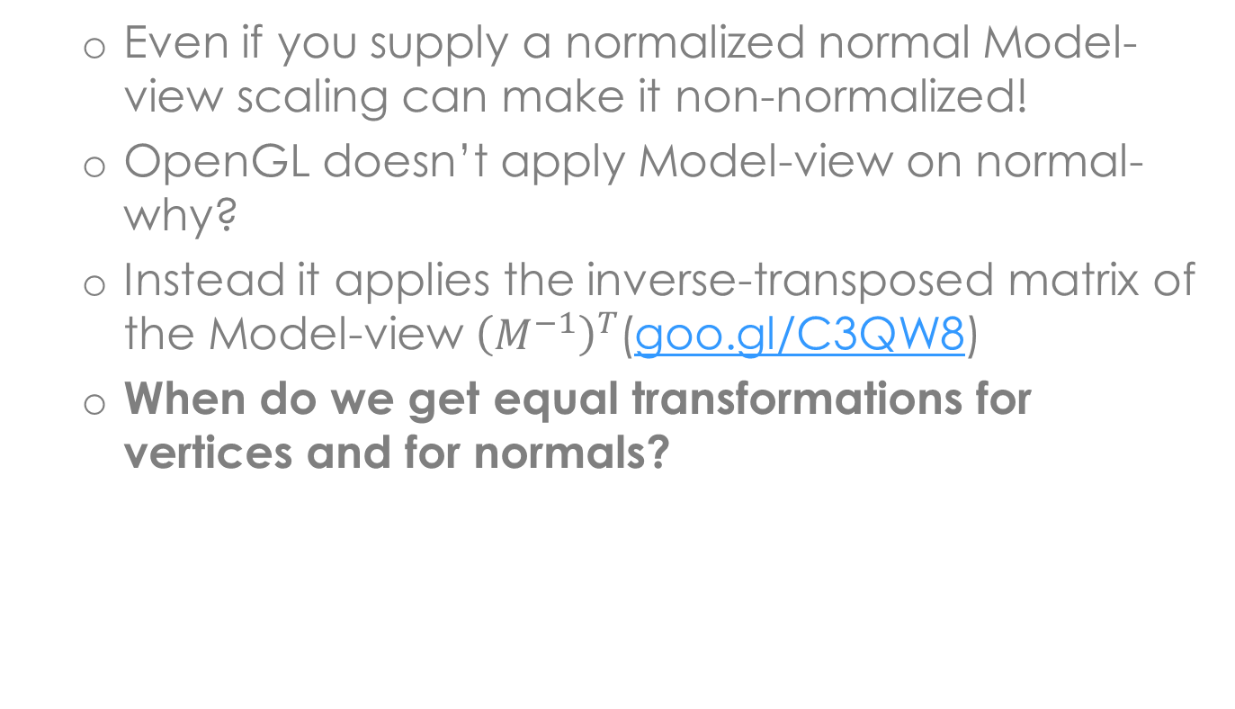
Transformations affect normals!
Even if you supply a normalized normal Model-view scaling can make it non-normalized!
OpenGL doesn’t apply Model-view on normal- why?
Instead it applies the inverse-transposed matrix of the Model-view ${\left(M^{−1}\right)}^{T}$(goo.gl/C3QW8)
When do we get equal transformations for vertices and for normals?

Slide 17
Step2: Materials
void glMaterial*(face, pname, param);
Specifies a current material property for use in lighting calculations.
Face can be GL_FRONT, GL_BACK, or GL_FRONT_AND_BACK to indicate which face of the object the material should be applied to.

Slide 18
Materials
Pname can be
GL_AMBIENT
GL_DIFFUSE
GL_SPECULAR
GL_EMISSION
GL_AMBIENT_AND_DIFFUSE
GL_SHININESS
Example
float v[] = {1.0f, 0.0f, 0.0f, 1.0f};
gl.glMaterialfv(GL.GL_FRONT_AND_BACK,
GL.GL_DIFFUSE, v, 0);
*the last 0 argument is the offset in the v[] array

Slide 19

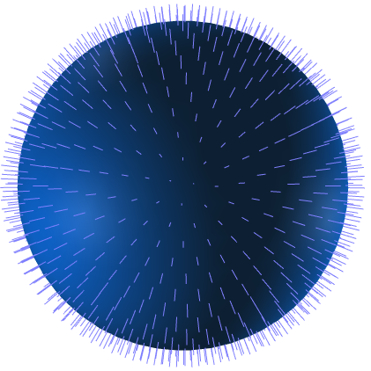
Step3: Lights
Create, select, and position one or more light sources.

Slide 20
Defining Lights
void glLight*(light, pname, param);
Addresses light specified by light, which can be GL_LIGHT0, ... , or GL_LIGHT7
The characteristic of the light being set is defined by pname, which specifies a named parameter
param indicates the values to which the pname characteristic is set.

Slide 21
Defining Lights
pname can get one of several values:
GL_AMBIENT, GL_DIFFUSE & GL_SPECULAR define the light RGBA values for each of the light components.
gl.glLightfv(GL.GL_LIGHT1,
GL.GL_DIFFUSE, new float[] {1f,1f,1f,1f}, 0);
gl.glLightfv(GL.GL_LIGHT1,
GL.GL_AMBIENT, new float[] {0f,0f,0f,0f}, 0);

Slide 22
Directional and Positional Lights
Directional light source is positioned at infinity (like the sun).
Positional light source is positioned near the scene and its exact position determines its effect.

Slide 23
Positioning Lights
when GL_POSITION is passed as an argument to glLight*() four values (x,y,z,w) are passed as parameters.
W determines the type of light we are defining:
0 ⬄ directional - (x,y,z) is the direction.
1 ⬄ positional - (x,y,z) is the position.
(x,y,z,w) can be viewed as homogeneous coordinates
gl.glLightfv(GL.GL_LIGHT1,
GL.GL_POSITION, new float[] {0f,10f,0f,0f}, 0);

Slide 24
Lighting Position
Relative to GL_MODELVIEW
How to simulate a flashlight?
paintEvent()
{
glMatrixMode(GL_MODELVIEW)
glLoadIdentity()
gluLookAt(…)
glLight(GL_POSITION,0,0,1,1)
glRotate(model_rotation)
renderModel()
}
paintEvent()
{
glMatrixMode(GL_MODELVIEW)
glLoadIdentity()
gluLookAt(…)
glRotate(model_rotation)
glLight(GL_POSITION,0,0,1,1)
renderModel()
}
Notes:
אור נשאר עם מודל (ימין) או אור נשאר קבוע ביחס לעולם (שמאל)

Slide 25
Defining Lights: Specular step-by-step
To define specular lighting, define light source:
gl.glEnable(GL.GL_LIGHTING);
gl.glEnable(GL.GL_LIGHT0);
gl.glLightfv(GL.GL_LIGHT0, GL.GL_SPECULAR, new float[] {1f,1f,0f,0f}, 0);
gl.glLightfv(GL.GL_LIGHT0, GL.GL_POSITION, new float[] {0.5f,1,1,0}, 0);
And material:
gl.glMaterialfv(GL.GL_FRONT_AND_BACK, GL.GL_SPECULAR, new float[] {1f,1f,1f,1} , 0);
gl.glMaterialf(GL.GL_FRONT_AND_BACK, GL.GL_SHININESS, 10f);

Slide 26

Additional Options
GL_CONSTANT_ATTENUATION, GL_LINEAR_ATTENUATION, GL_QUADRATIC_ATTENUATION.
These define the attenuation of the light. Usually disabled for directional lights.
GL_SPOT_DIRECTION, GL_SPOT_EXPONENT,
GL_SPOT_CUTOFF.
These define spotlights and spotlight properties.
exponent
cutoff

Slide 27
Example
gl.glLightfv(GL.GL_LIGHT1, GL.GL_POSITION, new float[] {0,0,0,1}, 0);
gl.glLightf(GL.GL_LIGHT1,
GL.GL_SPOT_CUTOFF, 10);
gl.glLightf(GL.GL_LIGHT1,
GL.GL_SPOT_EXPONENT, 100f);
gl.glLightf(GL.GL_LIGHT1,
GL.GL_QUADRATIC_ATTENUATION, 0.5f);
Notes:
TODO: GL_SPOT_POSTION

Slide 28
Multiple Light Sources
You can define several light sources by calling glLight*() several times with different light names:
glLightfv(GL_LIGHT0, GL_AMBIENT, light0_ambient);
glLightfv(GL_LIGHT1, GL_AMBIENT, light1_ambient);

Slide 29
Let There Be Light
Turning on the lighting model:
glEnable(GL_LIGHTING);
This makes OpenGL ignore glColor and instead take vertex color from lighting model
Turning on light sources
glEnable(GL_LIGHT#);
Remember – Each extra light require significant computation time

Slide 30
OpenGL Lighting Model

Slide 31
Lighting Model Attributes
void glLightModel*(pname, param);
GL_LIGHT_MODEL_AMBIENT
defines the global ambient RGBA values.
Default: (0.2, 0.2, 0.2, 1.0)
GL_LIGHT_MODEL_TWO_SIDE
determines whether we are using two sided lighting.
Default: false
Example: gl.glLightModeli( GL.GL_LIGHT_MODEL_TWO_SIDE, GL.GL_TRUE);

Slide 32
Missed glColor?
void glColorMaterial(face, mode);
cause a material color to track the current color (set by glColor) for the specified attributes
face
GL_FRONT, GL_BACK, or GL_FRONT_AND_BACK
mode
GL_EMISSION, GL_AMBIENT, GL_DIFFUSE, GL_SPECULAR, and GL_AMBIENT_AND_DIFFUSE
Has to be enabled
gl.glEnable(GL.GL_COLOR_MATERIAL);

Slide 33
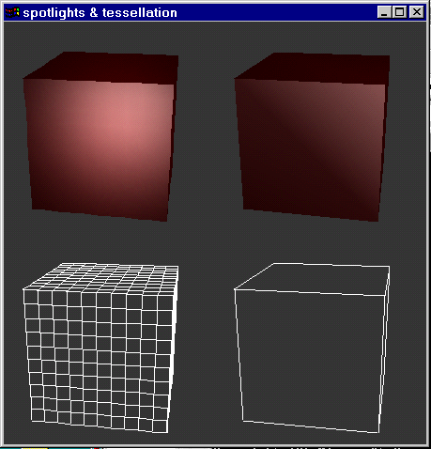
Lighting Limitations

Slide 34
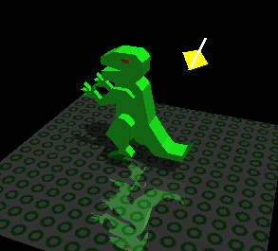
Global Illumination in OpenGL
…Can the lighting model calculate shadows?
The effects of Shadows and Reflection are obtained using various advanced techniques
Does not compute

Slide 35
Simple Text
Rendering 2D letters

Slide 36
Simple Text
Set raster position in pixel coordinates
gl.glWindowPos*(x,y)
Draw text
GLUT glut = new GLUT();
glut.glutBitmapString(font, string);
font could be GLUT_BITMAP_9_BY_15, GLUT_BITMAP_8_BY_13, GLUT_BITMAP_HELVETICA_18, GLUT_BITMAP_HELVETICA_12, GLUT_BITMAP_HELVETICA_10, GLUT_BITMAP_TIMES_ROMAN_24, GLUT_BITMAP_TIMES_ROMAN_10
openglut.sourceforge.net/group__bitmapfont.html
Not very versatile…
No Hebrew…
Better options exist

Slide 37
Simple Text Troubleshooting
You might want to disable the following while rendering text:
Lighting
Depth test
Example
gl.glDisable(GL.GL_DEPTH_TEST);
gl.glDisable(GL.GL_LIGHTING);
gl.glColor3d(1, 0, 0);
gl.glWindowPos2d(50, 100);
GLUT glut = new GLUT();
glut.glutBitmapString(GLUT.BITMAP_HELVETICA_12,
"My OpenGL text");
gl.glEnable(GL.GL_LIGHTING);
gl.glEnable(GL.GL_DEPTH_TEST);

Slide 38
Code Framework For OpenGL app
Model-View-Controller(app) Design
Viewer class
implements GLEventListener (attached to the panel)- deals with display, reshape etc.
Controller class
deals with the user input, attaches ActionListeners to the Panel the code overriding methods for dealing with key/mouse events is here.
The controller is “dumb”. It contains simple managing logic and calls methods implemented in the viewer or in the model
holds the models
Usually the Viewer sets the camera and scene lighting

Slide 39
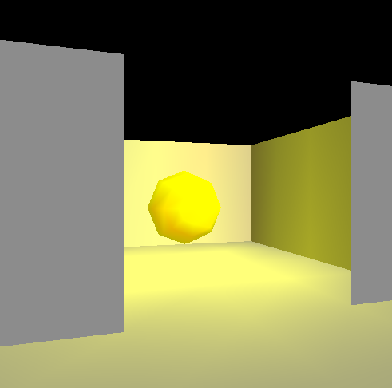
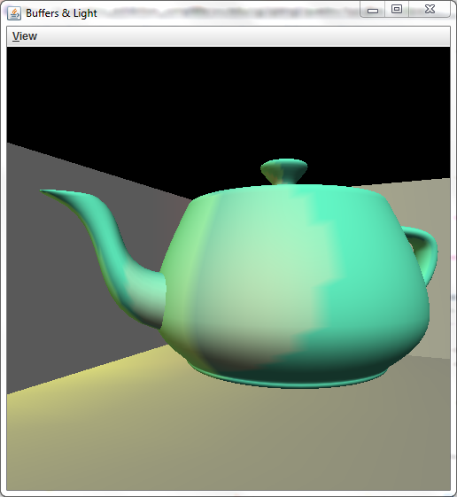
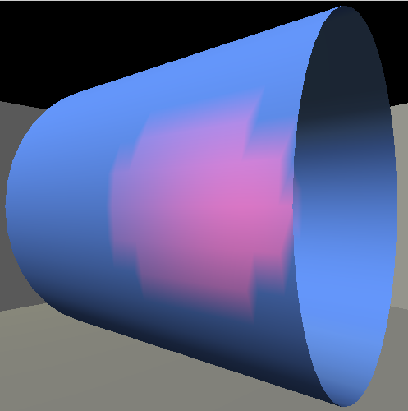
Quadrics in an Exhibition
Let’s go through the code together
Notes:
Go through
init- set constant attributes of lights, animation setup
display- position of flashlight, camera setup (use control keys input), position of other lights, draw objects, advance time
Reshape- change projection

